Slide 1
PROMOTION OF MILLETS IN TAMILNADU NATIONAL LEVEL WORKSHOP ON MILLETS
DATE: 28.09.2018
VENUE:Vaikunth Mehta National Institute of Cooperative Management(VAMNICOM).Pune
George Mammen.
Deputy Director of Agriculture(Paddy& Millets)
T.Thanasekaran
. State Level Consultant(NFSM)
Directorate of Agriculture.Chennai

Slide 2
AGRICULTURE SCENARIO
Geographical area - 13.033 M.ha.
Gross area sown - 6.074 M.ha.(47%)
Net area sown - 4.833 M.ha.(37%)
Gross Area Irrigated - 3.575 M.ha (59%)
Net Area Irrigated - 2.833 M.ha (59%)
Rainfed - 2.499 M. ha
Average Rainfall -921 mm – {National-1200mm}
No. of land holdings - 8.118 Million
Average size of holding - 0.80 Ha. {National -1.15 ha.}
SF/MF - 92% (operating 61% area)
Other Farmers - 8% (operating 39%area)

Slide 3
TAMIL NADU POSITION AT ALL INDIA LEVEL
Crop | All India Average Yield (Kg/ha) | Yield in Tamil Nadu (Kg/ha) | Position of Tamil Nadu at National Level
Maize | 2,557 | 5,360 | 1
Bajra | 1,272 | 2,881 | 1
Groundnut | 1,400 | 2,699 | 1
Total Oilseeds | 1,037 | 2,294 | 1
Cotton | 461 | 718 | 1
Rice | 2,390 | 3,191 | 2
Sugarcane(MT) | 70 | 93 | 3
Sunflower | 753 | 1,625 | 3
Jowar | 953 | 1,485 | 3
Coarse cereals | 1,729 | 3,066 | 4
Food grains | 2,070 | 2,529 | 5
Total Pulses | 744 | 698 | 8

Slide 4
Agricultural Scenario
Tamil Nadu has 4% of the land area and 3% of the water resources at National level.
92% of total land holdings in Tamil Nadu belong to Small and Marginal farmers.
Agriculture is the major livelihood provider to about 40% of the population of Tamil Nadu Nearly 90% of underground water potential has been exploited
Tamil Nadu depends on the performance of monsoons and release of water from Mettur Dam.

Slide 5
Significance of Millets
The government of India has declared 2018 as the National year of Millets.
Millets is one of the oldest food known to mankind.
Millets hold enormous hope for food and nutritional security.
They are predominantly grown in areas with low rainfall and contributes to food and fodder requirements.
Millets need very little inputs for their sustenance and require only 25% of the water consumed by irrigated crops.
Millets are a pest free crops and is highly suitable for organic farming.

Slide 6
Superior nutritional characteristics of millets
Millets contain high amounts of proteins and fibre, B-complex vitamins including niacin, thiamine and riboflavin, the essential sulphur-containing amino acid methionine, lecithin and some vitamin E.
Rich in iron, magnesium, calcium and potassium.
Contain phyto-nutrients, including phytic acid, which is believed to lower cholesterol and phytate, which is associated with reducing risk of cancer.

Slide 7
Millet cultivating Districts in Tamil Nadu
Sl. No | Name of the Crop | Predominant district
1. | Jowar | Salem, Coimbatore, Trichy, Karur, Tirupur, Namakkal, Dindigul, Virudhunagar, Theni
2. | Bajra (Pearl millet) | Villupuram, Thoothukudi, Madurai
3. | Ragi (Finger millet) | Dharmapuri, Krishnagiri, Salem
4. | Maize | Nammakal, Salem, Tiruppur, Erode, Perambalur, Ariyalur, Theni, Dindigul, Viruthunagar, Thoothukudi,Coimbatore
5. | Kudhiraivali (Barnyard millet) | Madurai, Virudhunagar.
6. | Varagu (Kodo millet) | Cuddalore, Villupuram
7. | Samai (Little millet) | Vellore, T.V.Malai, Dharmapuri, Krishnagiri
8. | Tenai (Fox tail millet) | Salem
9. | Panivaragu (Proso millet) | Salem

Slide 8
RULING VARIETIES
Jowar | Co(S) 28, K11, CSH 14 ,CoS 30,K12
Bajra | ICMV 221,Co(cu)9 Co(cu)10,Dhansakthi
Ragi | GPU 67, Co 14, Co 13, MR1, Co15,
Maize | Co1, CoHM5 ,CoHM6 and Hybrids
Little Millet | Co4.
Kodo Millet | Co3, Co4.
Foxtail Millet | Co (Te)7, Co6.
Proso Millet | Co4.

Slide 9
Area and Production of Millets in Tamil Nadu

Slide 10
CONSTRAINTS IN MILLET CULTIVATION
Changes in the consumption pattern
Erratic Rain Fall due to vagaries in Monsoon.
Declining farm size
Major area under rainfed condition and cultivation of poor yielding local varieties,.
Non availability of High yielding Hybrids/HYV except Maize and Bajra.
Farmers not able to obtain Remunerative price leading to lesser returns.
Lack of awareness of Improved methods of Production & Technologies.
Weak post harvesting & market linkages
Lack of Public Procurement & Marketing.
Declining investment in agriculture by Public & Private sectors

Slide 11
Year wise Food Grain Area and Production
Year | Area (M.Ha.) | Prodn. (M.MT)
2009-10 | 3.034 | 7.505
2010-11 | 3.174 | 7.594
2011-12* | 3.209 | 10.152
2012-13 | 2.648 | 5.605
2013-14 ** | 3.475 | 11.002
2014-15 | 3.741 | 12.795
2015-16 # | 3.755 | 11.370
2016-17 @ | 2.946 | 5.238
2017-18 | 3.636 | 11.484
(*) Krishi Karman Award for the Highest Food Grain Production in the country
(**) Krishi Karman Award for the Highest Pulses Production in the country
(#) Krishi Karman Award for the Highest Coarse Cereals in the country
(@) Krishi Karman Award for the Highest Food Grain Production in the country

Slide 12
Millets Area Coverage and Production Programme 2018-19
Crop | Area (Lakh. Ha) |  |  | Production (Lakh Mt)
 | Kharif | Rabi | Total | Kharif | Rabi | Total
Jowar | 2.303 | 1.787 | 4.090 | 4.535 | 3.339 | 7.874
Bajra | 0.320 | 0.411 | 0.731 | 0.759 | 0.880 | 1.640
Ragi | 0.777 | 0.243 | 1.020 | 2.233 | 0.754 | 2.987
Maize | 1.929 | 1.900 | 3.829 | 16.238 | 12.909 | 29.147
Minor Millet | 0.265 | 0.065 | 0.330 | 0.306 | 0.047 | 0.353
Total Millet | 5.594 | 4.406 | 10.00 | 24.071 | 17.929 | 42.00

Slide 13
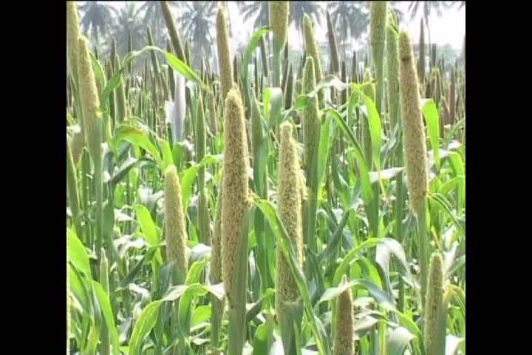
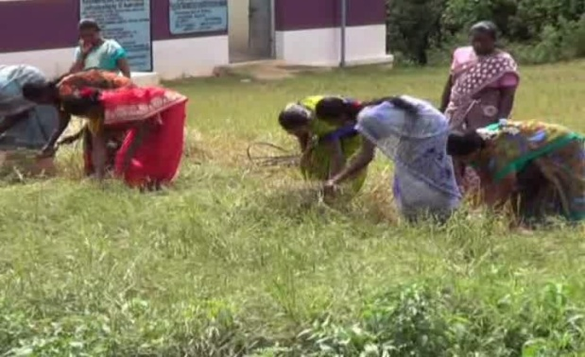
STRATEGIES to increase the production in MILLETS
Replacing the traditional long duration low yielding varieties with high yielding short duration varieties
Bringing additional area of millets in the current fallow areas in a phased manner.
Interventions - cluster demonstration, distribution of certified seeds of High Yielding Varieties, Seed drill sowing, Community sowing, Intercropping with pulses and local initiatives (Need based technologies) included under NFSM- coarse cereals & Nutricereals.
Productivity enhancing Inputs - Liquid biofertilizer, Maize booster / plant growth regulator , MN Mixture & Biocides
Direct Procurement centres to procure Millets.
Financial assistance for Post Harvest Management and Value addition by establishment of modern millet based processing units.
Seed Production through Seed Hubs.

Slide 14
SPECIAL INTIATIVES FOR INCREASING THE PRODUCTION AND FARMERS INCOME IN TAMILNADU
ESTABLISHMENT OF TAMIL NADU STATE SEED DEVELOPMENT AGENCY
Exclusively for Seed Production activities ensuring
Farmers preferred quality certified seeds
Fixation of uniform procurement and sale price
MISSION ON SUSTAINABLE DRY LAND AGRICULTURE (MSDA)
Focus to improve production and productivity of Millets, Pulses Oil seeds and Cotton
Extented to 25 Lakh Acre of Dryland
Cluster Approach
COLLECTIVE FARMING
Organizing small and marginal farmers into Farmers Interest Groups (FIGs)
‘Farmer Producer Groups’ (FPGs)
Federated into ‘Farmer Producer Organizations’ (FPO/FPCs)

Slide 15
NFSM – Coarse Cereals (Maize) – 2018-19
Sl.No. | Name of the Component | Unit | Assistance per unit. In Rs | Physical | Finance (Rs. in Lakh)
1. | Demonstrations
(a) | Demonstrations on Improved Packages (Maize) | Ha | Rs.6000 | 3000 | 180.000
(b) | Demonstrations on Intercropping
 | (i) Maize with Blackgram | Ha | Rs.6000 | 400 | 24.000
 | (ii) Maize with Greengram | Ha | Rs.6000 | 400 | 24.000
 | Sub total 1 (b) |  |  | 800 | 48.000
 | Total for Demonstrations(1a &1b) |  |  |  | 228.000
2 | Distribution of Certified Seeds - Hybrid Seeds of Maize | Qtl | Rs.10000 | 982 | 98.200
 | Total – NFSM - Coarse Cereals –(Maize) |  |  |  | 326.200
 | Central share |  |  |  | 195.720
 | State share |  |  |  | 130.480

Slide 16
NFSM – Nutri - Cereals – 2018-19
Sl.No. | Name of the Component | Unit | Assistance per unit. In Rs | Physical | Finance (Rs. in Lakh )
1. | Cluster Front Line Demonstrations (60:40) | Ha | Rs. 5000/ per ha | 5040 | 252.000
2 | Distribution of Seed (60:40)
 | (a) Hybrid Seed of Nutritive variety | Qtl | Rs. 10000/qtl | 311.85 | 31.185
 | b) HYVs Seed |  |  | 4054.05 | 93.555
3. | Certified Seed Production of HYVs Seed (< 10 years old varieties) (60:40) | Qtl | Rs. 3000/Qtl | 4074.00 | 122.220
4. | Integrated Nutrient Management (INM) (60:40) | Ha |  | 24000 | 100.000
5. | Integrated Pest Management (IPM) (60:40) | Ha | Rs. 500/ha | 28948 | 24.740
6 | Farm Implements & Equipments (60:40) |  |  | 7000 | 38.000
 | TOTAL |  |  |  | 661.700

Slide 17
NFSM – Coarse Cereals – 2018-19
Sl.No. | Name of the Component | Unit | Assistance per unit. In Rs | Physical | Finance (Rs. in Lakh )
1. | Cluster Front Line Demonstrations (60:40) | Ha | Rs. 6000/ per ha | 3800 | 228.000
2 | Distribution of Seed (60:40)
 | (a) Hybrid Seed of Maize | Qtl | Rs. 10000/qtl | 982 | 98.20
 | TOTAL |  |  |  | 326.200

Slide 18
IMPACT OF NFSM PROGRAMMES
S.No | Crop | 2011-12 |  | 2017-18
 |  | Area (L.Ha) | Production(L.Mt) | Area (L.Ha) | Production (L.Mt)
1 | Jowar | 1.98 | 2.53 | 3.86 | 4.21
2 | Bajra | 0.47 | 1.14 | 0.69 | 1.65
3 | Ragi | 0.83 | 2.25 | 0.91 | 3.27
4 | Maize | 2.81 | 16.96 | 3.41 | 27.17
5 | Foxtail Millet | 0.01 | 0.00 | 0.02 | 0.01
6 | Kodo Millet | 0.04 | 0.08 | 0.02 | 0.03
7 | Little Millet | 0.20 | 0.25 | 0.17 | 0.19
8 | Other millets | 0.05 | 0.03 | 0.09 | 0.05
Total Millets |  | 6.38 | 23.24 | 9.16 | 36.57

Slide 19
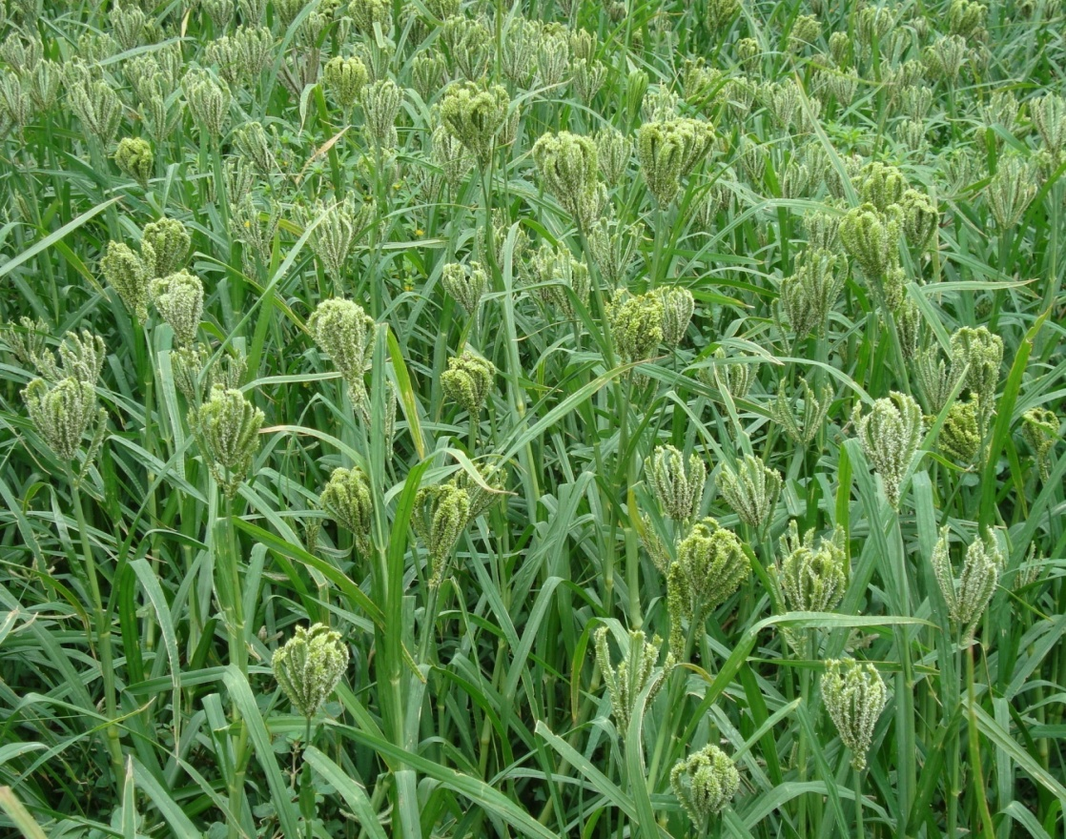
THANK YOU

