Slide 1
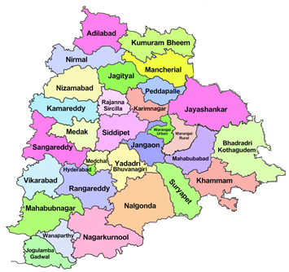
National Level Workshops on Nutricereals (Millets)
On 28.09.2018 at YASHADA, Pune
DEPARTMENT OF AGRICULTURE, TELANGANA

Slide 2
Introduction
The financial year 2018-19 has been declared as National Year of Millets.
In view of National Year of Millets NFSM- Coarse cereals (under 60:40 sharing pattern) have been divided into
NFSM-Coarse Cereals (Maize)
Sub-Mission on Nutricereals (Jowar, Bajra, Ragi & Korra)

Slide 3
BACK GROUND OF MILLETS SCENARIO IN TELANGANA STATE
Telangana is characterized by Dry Land Agriculture and requires synergy between cropping patterns and dietary choices.
It is traditionally millet belt, staple food.
The area and production under Millets is decreasing is year by year.
Food habits of people have changed and shifted rice based food due to many reasons causing severe malnutrition and health hazardous.
In present scenario the Millet Food which was previously known to be “Poor Man’s Food” became “Rich-Man’s Breakfast”.
In view of the adoptability / Resistance to the drought and moisture stress, eco friendly, organic by nature with high nutrition value it is need of hour for concentrating on increasing millet production and productivity through area expansion.

Slide 4
Area, Yield & Production of Millets
Year | Crop | Area(Ha.) | Yield (Kgs/Ha.) | Production (Tonnes)
2014-15 | Maize | 691471 | 3338 | 2308051
 | JOWAR | 79001 | 1054 | 83267
 | BAJRA | 11218 | 937 | 10510
 | RAGI | 1527 | 1145 | 1748
 | KORRA | 134 | 633 | 85
 | Total Millets | 783351 | 7107 | 2403661
2015-16 | Maize | 572794 | 3057 | 1751074
 | JOWAR | 76358 | 991 | 75703
 | BAJRA | 5900 | 938 | 5534
 | RAGI | 920 | 559 | 514
 | KORRA | 1310 | 817 | 1070
 | Total Millets | 657282 | 6362 | 1833895
2016-17 | Maize | 801822 | 3595 | 2882475
 | JOWAR | 89753 | 977 | 87701
 | BAJRA | 16697 | 869 | 14514
 | RAGI | 1134 | 1157 | 1312
 | KORRA | 852 | 938 | 800
 | Total Millets | 910258 | 7536 | 2986802
2017-18 | Maize | 632000 | 4258 | 2691000
 | JOWAR | 67000 | 1060 | 71000
 | BAJRA | 9000 | 1111 | 10000
 | RAGI | 1000 | 1147 | 1000
 | KORRA | 0 | 0 | 0
 | Total Millets | 709000 | 7576 | 2773000

Slide 5
Implementing Districts (13) in Telangana under Nutri Cereals (60:40)
Adilabad,
Mancheriyal
Wanaparthy
Gadwal
Siddipet
Rangareddy,
Nirmal
Asifabad
Mahabubnagar
Nagarkurnool
Medak
Sangareddy
Vikarabad

Slide 6
Progress Report –NUTRI CEREALS
S.No | Interventions | Target |  | Achievement
 |  | Phy. | Fin. | Phy. | Fin.
1 | Cluster Front Line Demonstration by State (60:40) | 1007 | 60.41 | 752 | 17.76
2 | Distribution of Seed (60:40)
 | (a) Hybrid seed of nutrietive variety (25 % of the total seed allocation of Jowar & Bajra) | 78 | 7.80 | 1 | 0.70
 | (b) HYVs seed | 1300 | 22.40 | 26 | 0.39
 | Total for Items 2 (a) & 2 (b) | 1378 | 30.20 | 27 | 1.09
3 | Certified Seed Production of HYVs seeds by State < 10 years old varieties (60:40) | 1007 | 30.20 | 75 | 2.25
4 | Integrated Nutrient Management (INM)-(60:40) | 3000 | 15.00 | 926 | 3.57
5 | Integrated Pest Management (IPM)- (60:40) | 3039 | 15.20 | 1067 | 4.44
 | Total for INM & IPM [Items 4+5] | 6039 | 30.20 | 1843 | 8.00
6 | Flexi Components
6(a) | Farm implements & equipments (60:40) | 1012 | 5.56 | 1 | 0.00
6(b) | Water application tools (60:40) | 58 | 5.80 | 0 | 0.00
6(c) | Cropping system based training (60:40) | 37 | 5.18 | 7 | 1.40
6(d) | Local Initiatives (60:40) (Accoustics) | 103 | 9.79 | 0 | 0.00
 | Total for Flexi Components [6 (a) to 6(d)] | 1210 | 26.33 | 8 | 1.40
 | Total NFSM - Nutri-Cereals | 10641 | 177.32 | 2852 | 29.67
 | GOI Share | 6384 | 106.39 | 1711 | 17.8
 | State Share | 4256 | 70.93 | 1141 | 11.87

Slide 7
Initiation of Department of Agriculture in Telangana State
To enhance the area and production of millets, with ultimate aim of increasing the millet consumption in the State, a special initiation has been taken by the Department to implement the programme in mission mode in six (6) districts viz., Adilabad, K.Asifabad, Mahabubnagar, Nagarkurnool, Sangareddy, and Vikarabad, in 36 mandals @ 200 acres per mandal covering an area of 7200 acres during 2018-19 in 1st phase.
As per the interventions and districts indicated by GoI action plan was submitted to GoI to the tune of Rs. 10.62 Crores.
The interventions include formation of FPOs, establishment of processing units, Center of excellence, creation of seed hubs, State and district levels events, workshops, food festivals, and road shows etc.

Slide 8
Interventions Proposed under NFSM
S.No. | Intervention proposed | Amount in Lakhs
1 | Center of excellence | 208.74
2 | Creation of Seed Hubs: | 69.12
3 | Events/workshop: | 56.244
4 | Formation of FPOs: | 98.04
5 | Creation of processing units: | 189.00
6 | Software development Programme | 30.00
Sub-Total |  | 651.144

Slide 9
Interventions Proposed under RKVY
S. No | Interventions | Amount in Lakhs
1 | Improving Soil Health | 45.00
2 | Improved Agronomic practices | 7.20
3 | Custom hiring centers | 144.00
4 | GP level community resource persons- technical (young farmers) | 12.96
5 | New Farm implements - trials with Jadigam + Gorru etc. | 18.00
6 | Developing baking products / new recipes 1 per district | 3.00
7 | Fabricators trainings | 0.60
8 | Technical support to PD ATMA for 36 mandals | 99.36
9 | Technical Support , Finance Management at State Level | 69.941
10 | State level events( ToTs, workshops etc. on need basis) | 3.00
16 | Documentation, evaluation reporting | 2.8584
 | Sub-Total | 411.68
 | Grand Total | 1062.82

Slide 10
For effective implementation of the programme, the seed was arranged to the farmers in these 6 districts duly sourcing from IIMR by TSSDC under 90% subsidy.
The awareness programmes, capacity building programme, demonstrations on improved agronomic practices are being organized at all levels to push up the programme among farming community.
The PDs of ATMA are the nodal agencies at district levels for effective implementation of the programme with coordination of local facilitating agencies.

Slide 11
Printing of Literature (Booklets) on Management Practices & Tasty Cuisine of Ragi (No of Pages-78)

Slide 12
Printing of Literature (Booklets) on Management Practices & Tasty Cuisine of Jonna (No of Pages-106)

Slide 13
Printing of Literature (Booklets) on Management Practices & Tasty Cuisine of Bajra (No of Pages-58)

Slide 14
Printing of Literature (Booklets) on Management Practices & Tasty Cuisine of Korra (No of Pages-50)

Slide 15
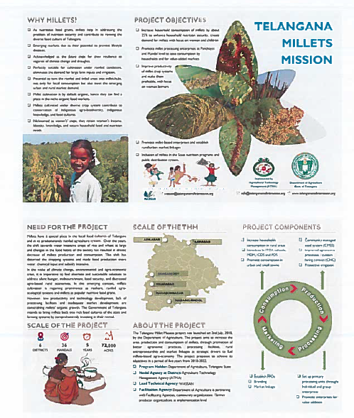

Slide 16
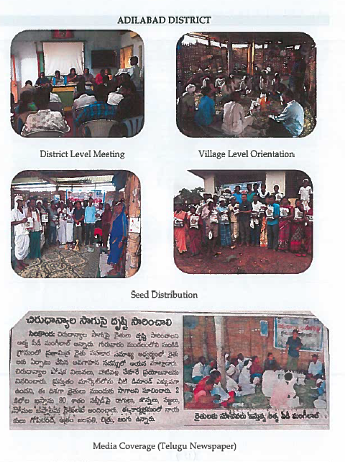
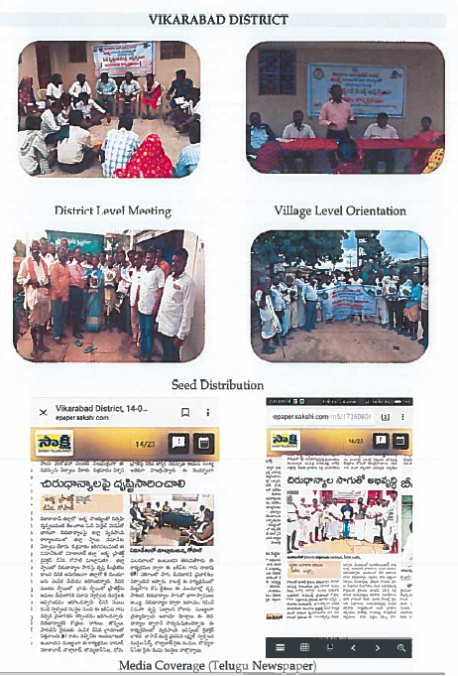
Different Activities

Slide 17
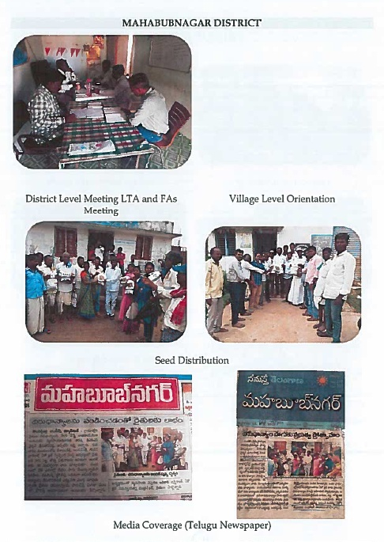
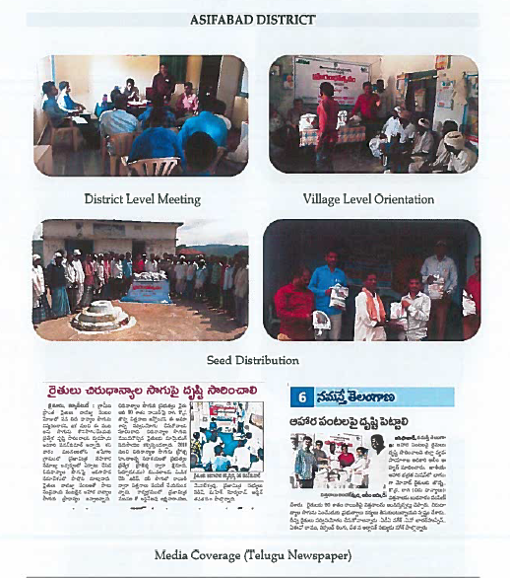

Slide 18
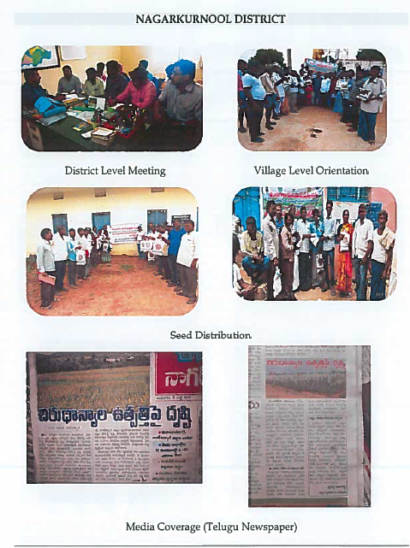
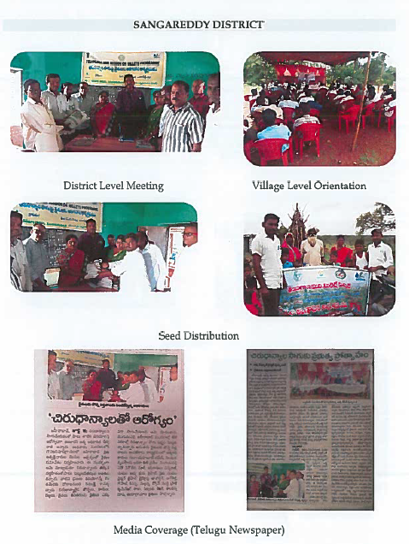

Slide 19
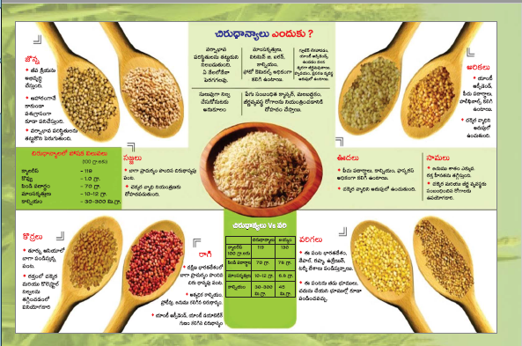
THANK YOU

