Slide 1


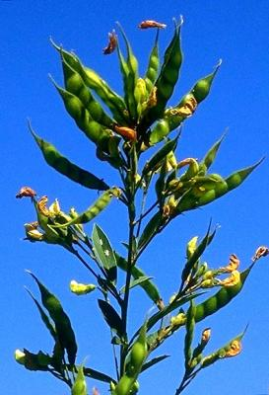
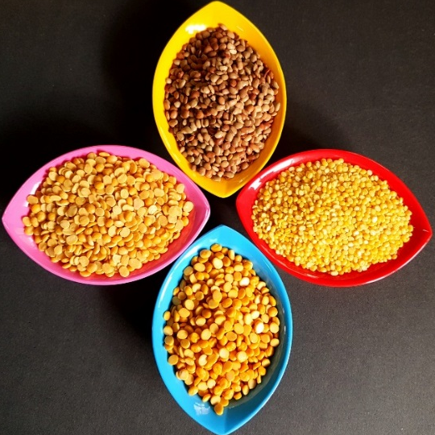
Grain products from CSIR-CFTRI
Srinivas. A
Head of the department of Grain Science and Technology
CSIR – Central Food Technological Research Institute
Mysuru – 570 020

Slide 2
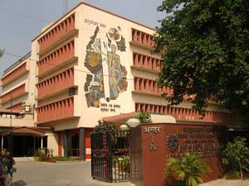
What is C.S.I.R?
Council of Scientific and Industrial Research
An autonomous Society under the Ministry of Science, Technology & Earth Sciences
The President of CSIR is OUR Prime Minister
There are 38 laboratories under CSIR
One of them is Central Food Technological Research Institute
With Headquarters at Mysore and branches at Hyderabad, Lucknow and Mumbai

Slide 3
Departments at CSIR - CFTRI
BIOCHEMISTRY
FLOUR MILLING BAKING & CONFECTIONERY TECHNOLOGY
MOLECULAR NUTRITION
FOOD PACKAGING TECHNOLOGY
SENSORY SCIENCE
GRAIN SCIENCE & TECHNOLOGY
SPICES AND FLAVOUR SCIENCES
FOOD PACKAGING TECHNOLOGY
MEAT & MARINE SCIENCES
FRUITS & VEGETABLES TECHNOLOGY
PLANT CELL & BIO-TECHNOLOGY
MICROBIOLOGY & FERMENTATION TECHNOLOGY
PROTEIN CHEMISTRY & TECHNOLOGY
MICROBIOLOGY & FERMENTATION TECHNOLOGY
LIPID SCIENCE
FOOD ENGINEERING
FOOD SAFETY & ANALATYCAL QUALITY CONTROL LABORATORY
INFESTATION CONTROL & PESTICIDES
SUPPORT DEPARTMENTS
HUMAN RESOURCE DEVELOPMENT

Slide 4


Human Resources Development Department
M. Sc (Food Technology) course
Short term training courses
Ph.D programmes:
  Other Universities
  AcSIR
Project Thesis and Dissertation
Recruitment of PAs

Slide 5

INNOVATION!

Slide 6
What is innovation?
Application of new solutions that meet new requirements, inarticulate needs, or existing market needs.
Through more effective products, processes, services, technologies or ideas that are readily available to markets, government and society
Something original and new that "breaks in to" the market or into society. One usually associates to new phenomena that are important in some way.
"An innovation is something original, new, & important - in whatever field - that obtains a foothold in a market or society."

Slide 7
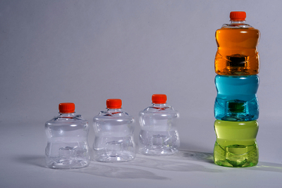
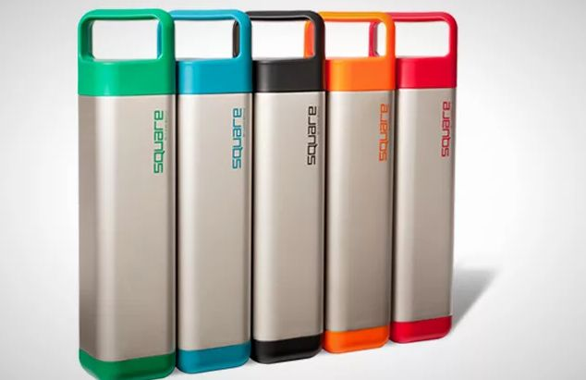

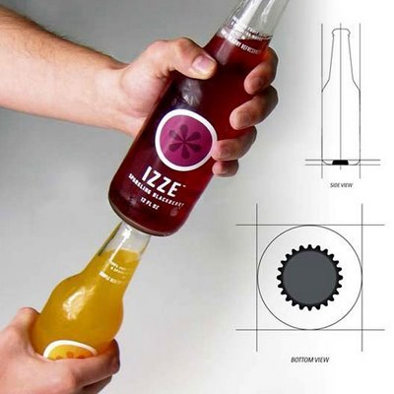
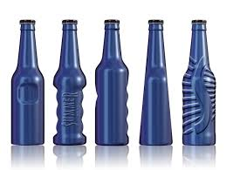
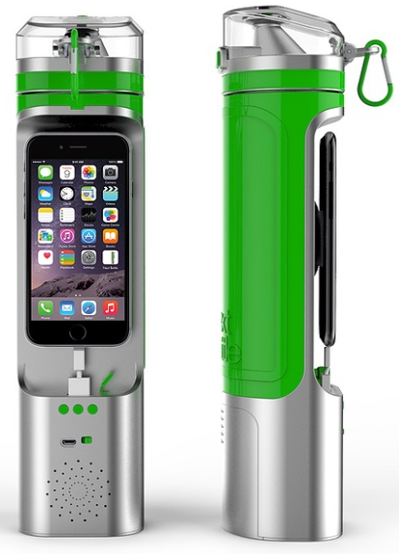


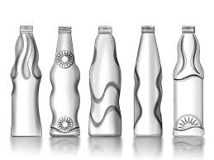
BOTTLE!
Bottle pictures are copyright of respective sources

Slide 8

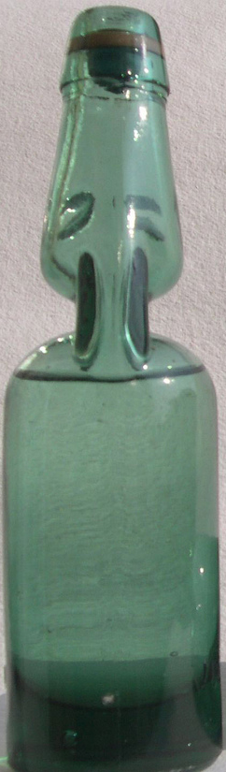
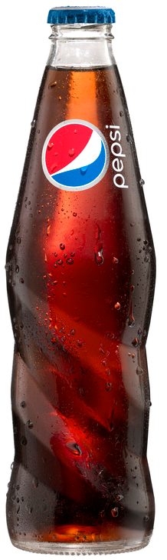


BOTTLES ACCORDING TO AGE
0-5
10-15
15-22
22-65
>65

Slide 9

INNOVATIONS IN
GRAIN PROCESSING

Slide 10
GST Department’s notable achievements since 1964
Hot soaking method of parboiling – FIRST TIME IN THE WORLD developed at GST Department and given to public FREE OF COST!! Late 1960s
Curing of paddy Late 1960s to early 1970s
Worked on producing rice from tapioca starch (known as Synthetic rice) since cost of rice was prohibitively high during those days Late 1960s to early 1970s
Instant ready mixes – viz., Idly, Vada, Dosa, Jamun, Jilebi, Chakli, Muchchorai, Tengolal, Rasam, Sambar, Bisi bele bhath, Pongal, Urd Bhath, Imli Poha, etc. Late 1970s to early 1980s
Developed the pressure type destoner machine During 1970s
Developed Mini Dhal Mill and distributed the same free of cost across the country for augmenting farmer’s income During late 1980s
In association with PCT Department developed “Energy food formulation” for distribution in schools
Developed the 1TPH maize dry milling system using indigenous machinery 1995 – 2000
Many sponsored and in-house projects taken up leading to development of many new technologies 2000 onwards

Slide 11
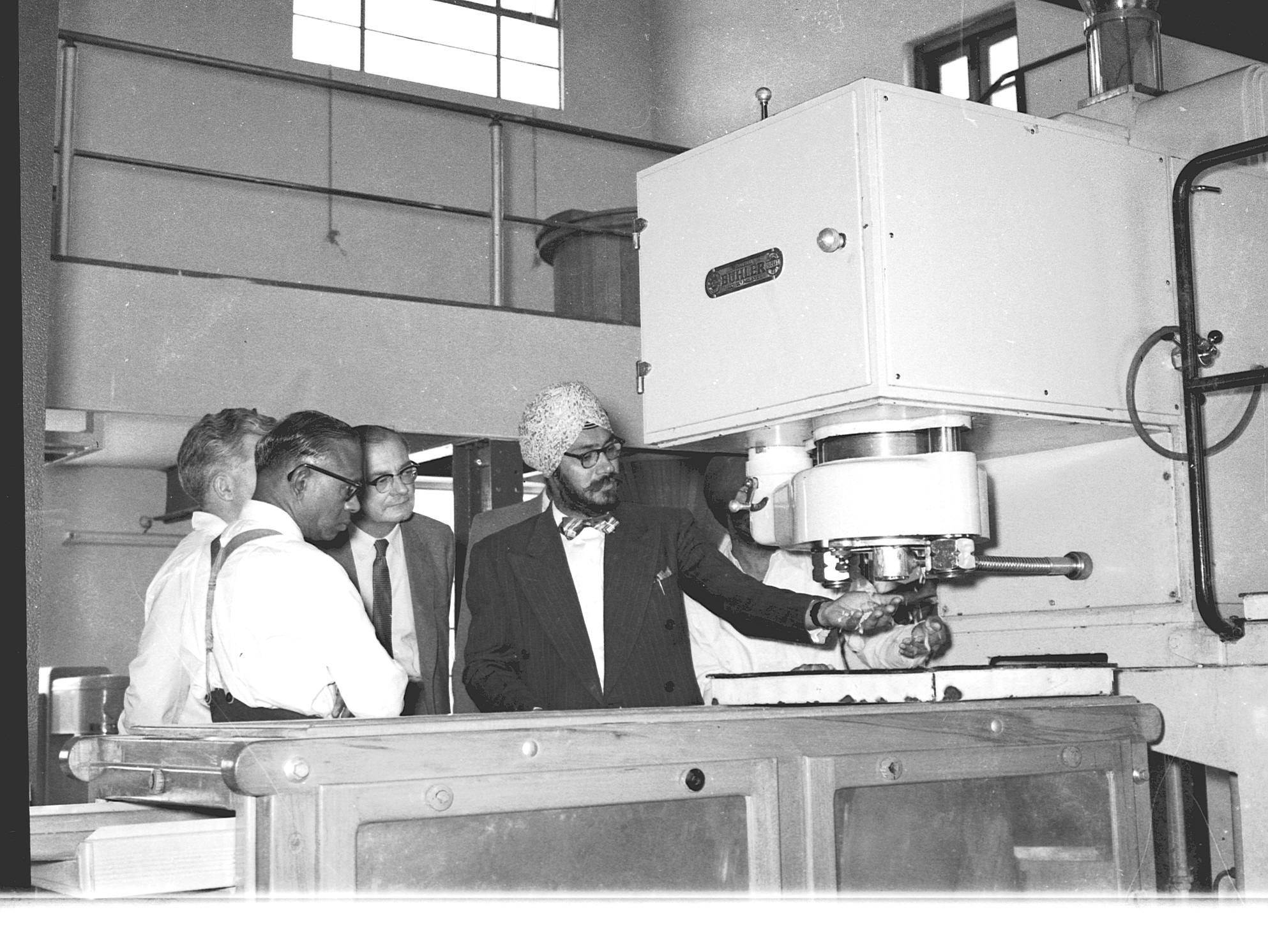

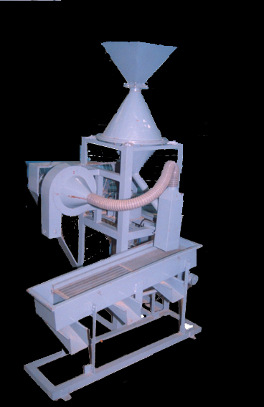
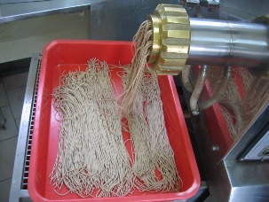
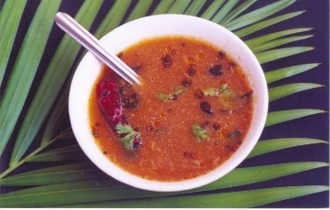
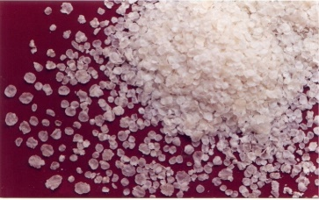
Synthetic rice plant
Synthetic rice hand graded by women
Millet vermicelli
Pulse based soup
Jowar flakes
Mini Dhal Mill

Slide 12
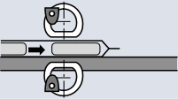
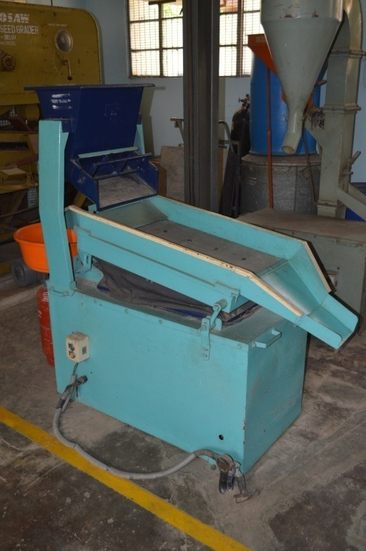
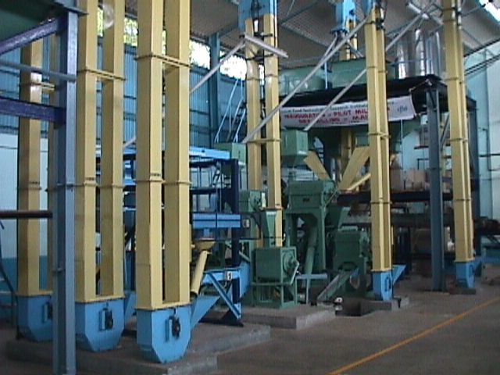
1TPH Maize Dry Milling Plant
Hot soaking method of parboiling
Same set up used for Curing of paddy
Destoner

Slide 13
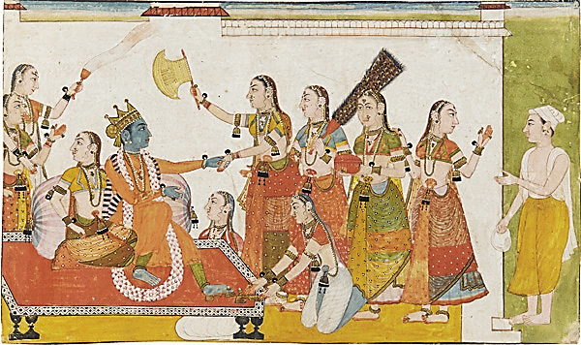
Grain processing is an ancient technology of India
~5000 years ago Sudama (Kuchela) gave rice flakes to Lord Krishna
Concept of eating whole grains mentioned in Vedas
Vedas and Upanishads mention the type of food to be eaten by us (from the womb to the tomb and beyond)
Aryans classified food materials on the basis of their nature and use such as शूखधान्य (cereals), शमिधान्य (pulses), फल (fruits), शाकम् (vegetables), पयोवर्ग (milk products), मध्यवर्ग (alcoholic beverages) and मांसवर्ग (animal products)

Slide 14
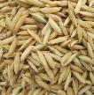










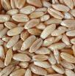
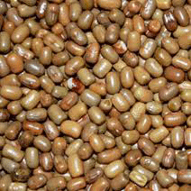

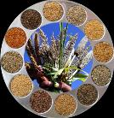






CEREALS
GRAINS
PULSES
MAJOR
COARSE
MILLETS
PSEUDO
MAJOR
MINOR
SORGHUM
BAJRA
AMARANTHUS
HORSE GRAM
BENGAL GRAM
PADDY
BUCK
WHEAT
KIDNEY BEAN
MAIZE
RAGI
RED GRAM
WHEAT
MOTH BEAN
BARLEY
QUINOA
BLACK GRAM
MILLETS
COW PEA
OATS
So many grains!!
GREEN GRAM
LENTIL

Slide 15
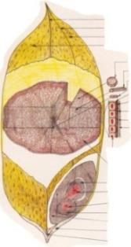
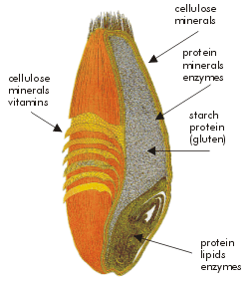
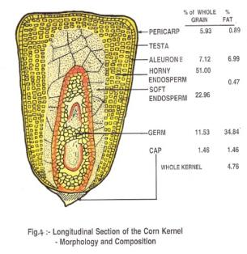
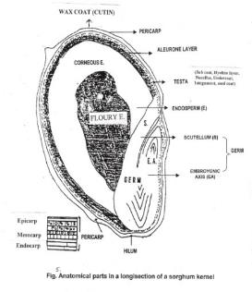
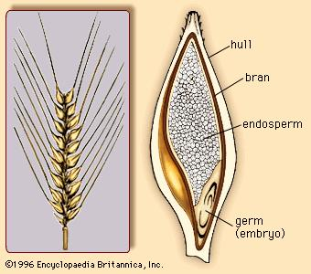

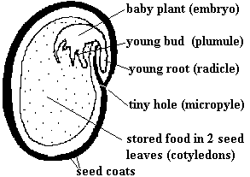
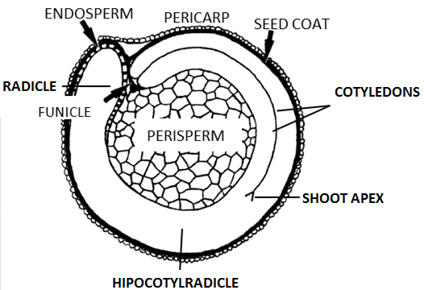
GRAIN PROCESSING MEANS DIFFERENT THINGS TO
DIFFERENT GRAINS AND DIFFERENT PEOPLE
PADDY
WHEAT
MAIZE
JOWAR
BARLEY
MILLET
PIGEON PEA
QUINOA
STRUCTURE, SHAPE, SIZE & COMPOSITION OF GRAINS ARE DIFFERENT FROM ONE ANOTHER

Slide 16
CEREALS
BARLEY
CHIA
FONIO
MAIZE
OATS
PADDY
RYE
SORGHUM
WHEAT
WILD RICE
MILLETS
BARNYARD MILLET
FINGER MILLET
FOXTAIL MILLET
KODO MILLET
LITTLE MILLET
PEARL MILLET
PROSO MILLET
PSEUDO-CEREALS
AMARANTHUS
BUCKWHEAT
CANARY GRASS
JOBS TEARS
KAÑIWA
PITSEED GOOSEFOOT
QUINOA
TEFF
TRITICALE
PULSES
PIGEON PEA
CHICK PEA
HORSE GRAM
GREEN GRAM
COW PEA
PEAS
LENTILS
KIDNEY BEANS
BLACK EYED BEANS
ADZUKI BEANS
BLACK BEANS
HARICOT BEANS
FIELD BEANS
PINTO BEANS
BUTTER BEANS
FLAT BEANS
BROAD BEANS
FLAGEOLET BEANS
CANNELINI BEANS
BORLOTTI BEANS
DUTCH BROWN BEANS
SOYA BEANS
BEIGE LENTILS
PUY LENTILS
RED LENTIL

Slide 17
Common grain processing avenues
Cooked whole
Dehulling
Germination
Raw, Cooked
Puffing
Wet grinding
Dry Grinding
Sev, Bajji, Bonda, flour,
Some eaten raw
Idli, Vada, Dosa
Dhal, millets, brown rice
Rice, dhal
Rice, horse gram, wheat

Slide 18
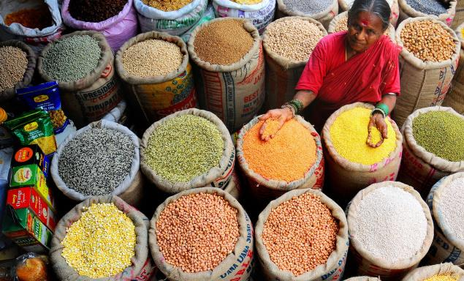
PROCESSES DEVELOPED:
DRY & WET HEAT PARBOILING
CURING OF FRESHLY HARVESTED PADDY
DETECTION BASMATI ADULTERATION
MALTED WEANING FOOD
REFINED MILLET FLOUR
NOODLES FROM CEREALS AND MILLETS
TAMARIND POWDER
CORIANDER DHAL “SUPARI”
CONTINUOUS CEREAL FLAKING SYSTEM FOR
  RICE, JOWAR, MAIZE, MILLETS, RAGI, OATS, PULSES

Slide 19
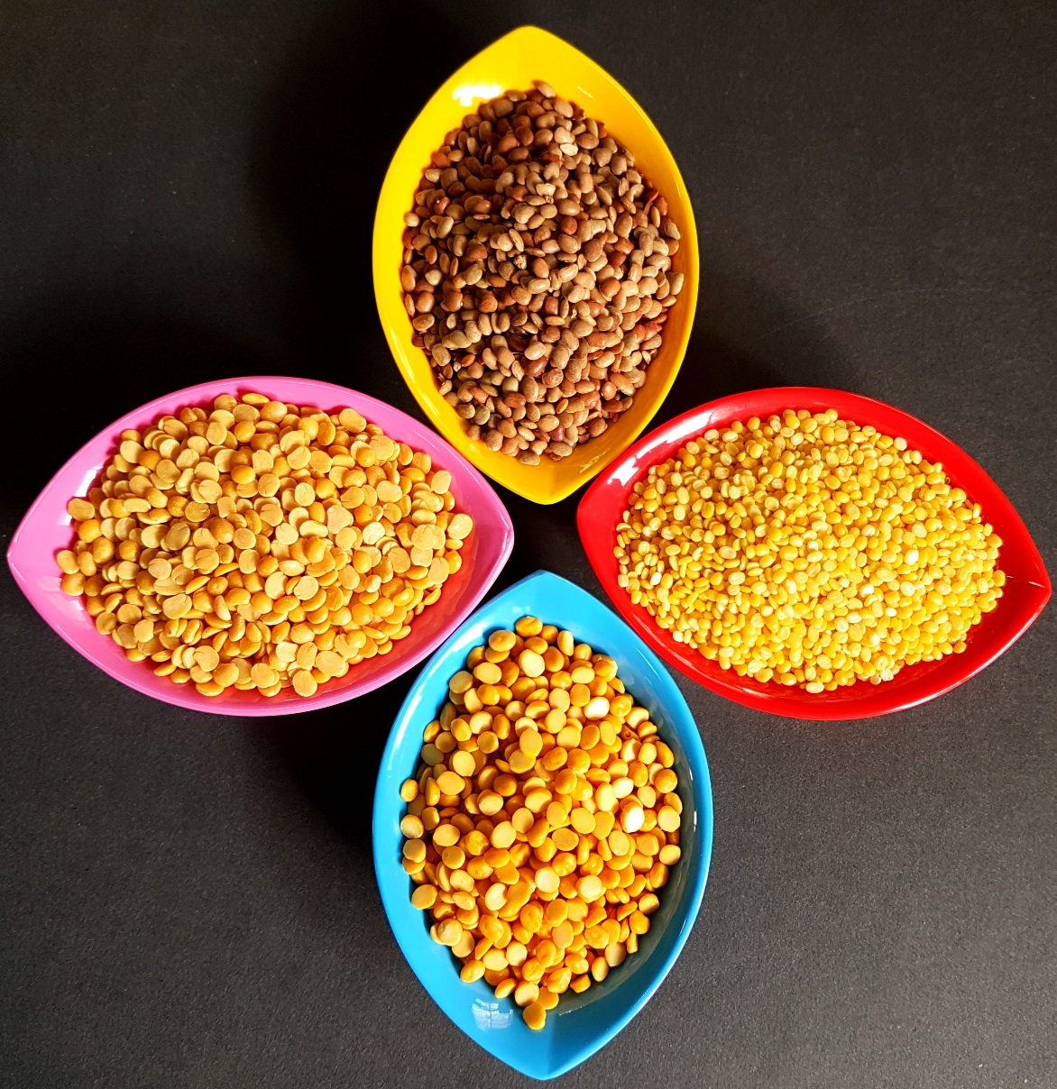
PROCESSES DEVELOPED:
ENTERAL FOOD FORMULATIONS
INFANT FOOD FORMULATIONS
HALWA MIX FORMULATION
WHOLE GRAIN DRINK MIX
MULTI GRAIN FLAKES
DIABETIC RICE
CONVENIENCE RAGI FLOUR FOR MAKING “MUDDE”
COMPOSITE LENTIL CHIPS

Slide 20

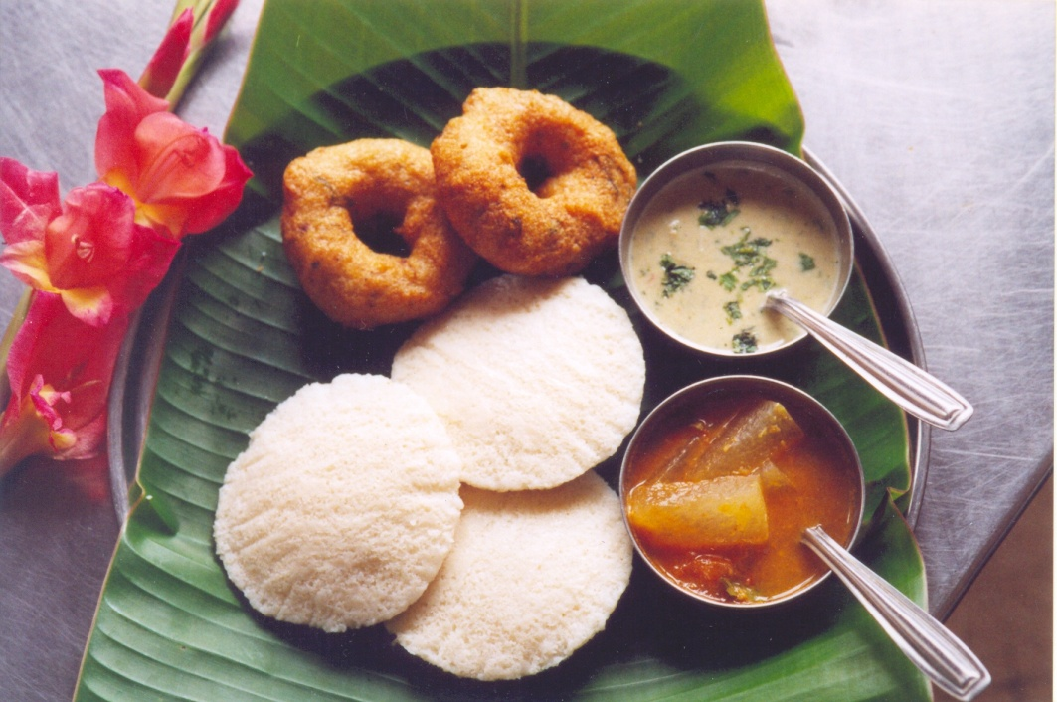
PRODUCTS DEVELOPED:
INSTANT TRADITIONAL FOODS
READY MIXES FOR:
  IDLI
  VADA
  DOSA
  JAMUN
  JILEBI
  CHAKLI
  MUCHCHORAI
  RASAM
  SAMBAR
  SPICE MIXES
  BISIBELE BHATH
  PULIOGARE
  PONGAL
  URD BHATH
MAIZE BASED PREPARATIONS
ORANGE PEEL CURRY
SHELF STABLE JOWAR FLOUR
IMPROVED MAIZE FLOUR
LOW FAT CHAKLI MIX
PILLOW SHAPED SNACK PRODUCT

Slide 21

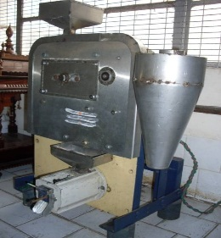
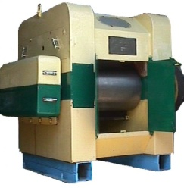
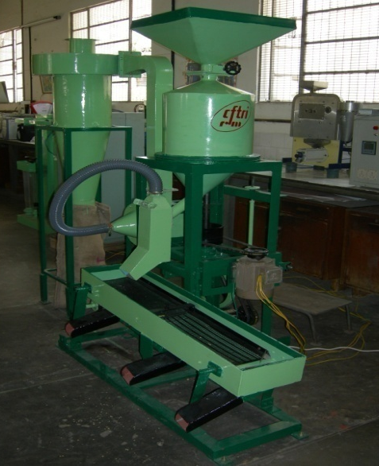
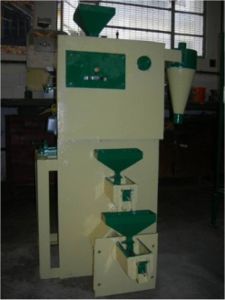
MACHINERY DEVELOPED:
INTEGRATED RUBBER ROLL SHELLER HULLER
PADDY PARBOILING PLANT (2 & 4 TPH)
HEAVY DUTY CEREAL ROLLER FLAKER
SIMPLE DHAL MILLING SYSTEMS:
  HAND OPERATED DHAL MILL
  MINI DHAL MILL
  VERSATILE DHAL MILL
  MINI VERSATILE DHAL MILL
MINI GRAIN MILL
PAPAD PRESS
PADDY CRACK DETECTOR
1TPH MAIZE MILLING PLANT
MILLET MILLING PLANT
TINY RICE MILL

Slide 22
OPTIMALLY MILLED BROWN RICE
VERMICELLI NOODLES FROM GRAINS
MALTING OF RICE, WHEAT AND SORGHUM
MAIZE ROTI FLOUR MIX
SHELF STABLE ROTI FROM NON-WHEAT CEREALS AND MILLETS
COMPOSITE LENTIL CHIPS
PUFFED MOTH BEAN SNACKS
MULTI-GRAIN BASED LOW-FAT FORTIFIED SNACK
MULTI-GRAIN BASED HEALTH DRINK MIX

Slide 23


A FEW PRODUCTS IN MORE DETAIL

Slide 24
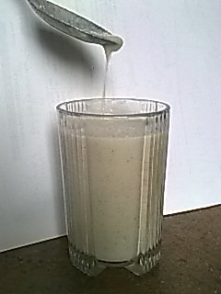
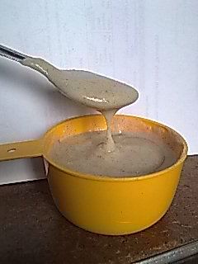
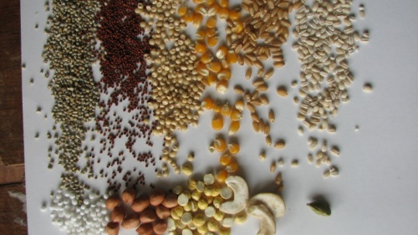
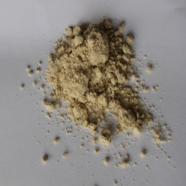
Ready to Cook Multi Whole Grain Mix for Drink / Porridge
Whole cereal based multi grain food for all age groups.
  An ideal blend to provide the benefits of nutrients and nutraceuticals in whole grains of ragi, pearl millet, sorghum, wheat, maize and barley.
  Rich in dietary fibre, proteins, vitamins, minerals and antioxidants compared to refined grains.
  Low carbohydrate digestibility, high antioxidant and vitamin E activity.
  Diet rich in whole grain foods & other plant foods and low in total fat, and cholesterol may help to reduce the risk of heart disease and certain cancers.
  Low cost and can be produced at rural scale.

Slide 25
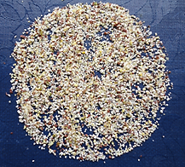
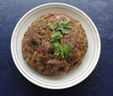
Finger millet based multigrain Semolina
Ragi, brown rice, wheat and pulse based RTC semolina mix
Good source of protein, minerals, vitamins, insoluble, soluble, total dietary fibre and nutraceuticals.
Can be made with minimum infrastructure.

Slide 26
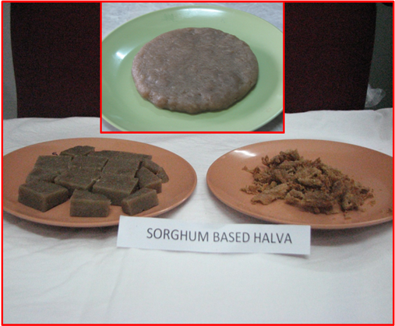
WHOLE SORGHUM BASED SWEET MIX (HALVA)
Ragi/ Sorghum/ wheat, rice, pulse and nuts based ready to cook mix
Rich in fibre, protein, iron, calcium, thiamine, etc.
Ideal for school children
Rural facilities sufficient to manufacture

Slide 27
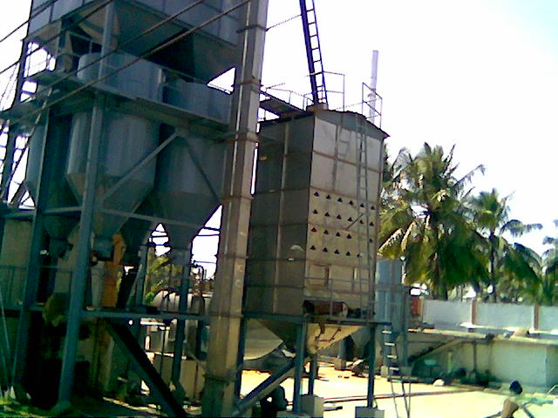
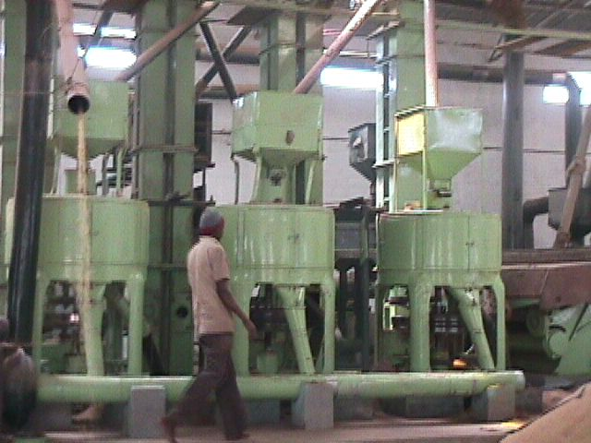
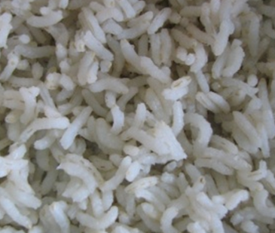
SHELF STABLE OPTIMALLY MILLED BROWN RICE
Consumption of highly refined rice can lead to diabetes, metabolic disorders, cardio-vascular diseases. So there is a need for minimally polished and brown rice.
Brown rice palatability can be improved by mild polish. But it will trigger lipase activity, FFA development, oxidation and storage problems.
Optimization of industrial scale hydrothermal treatment (HTT), continuous LSU drying and abrasion polishing result in a process for acceptable optimally milled brown rice with maximum retention of nutrients and nutraceuticals having 6-8 months shelf stability.

Slide 28
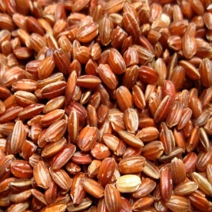
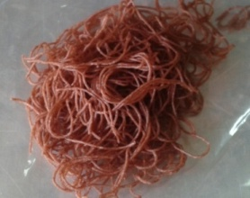





Convenience food products from unpolished red rice
Convenience products prepared using brown broken/whole red rice is rich in protein, minerals, soluble, insoluble and total dietary fiber
Compared to polished rice flour content of nutraceuticals like polyphenols, flavonoids, oryzanol, etc., are high
Instant Product
Cooked products
Red rice
Instant String hopper
Instant Vermicelli/ Noodle
Rice Roti (Pathiri)
String hopper (idiappam/ noolappam)
Ready to prepare multipurpose flour
INSTANT BREAKFAST STRINGS (Iron Fortified)

Slide 29





Bio-processed brown rice products
Wellness rice flour made from germinated whole red rice is rich in-
GABA which improves the brain function and reduces the blood pressure;
Gamma oryzanols having cholesterol lowering and anti-inflammatory property
Polyphenols having antioxidant activity.
Superior to currently available refined rice flour with respect to minerals and fibre content.
Wellness rice flour can be used for the preparation of traditional foods.
Wellness Rice Flour
Germinated red rice
Wellness rice flour
“Appam”
Pancake
“Puttu”

Slide 30


Instant Wellness Rice Flour
Instant germinated red rice based wellness flour can be used for the preparation of traditional sweets such as Laddu, Barfi etc., by mixing with milk, jaggery and coconut.
This flour is having GABA, oryzanol, polyphenols, fibre etc.
Can act as phytonutrient rich high calorie sweet for children.
Instant wellness rice flour
Laddoo

Slide 31

QUICK COOKING GERMINATED AND DEHYDRATED (QCGD) BENGAL GRAM
GERMINATED PULSES GENERALLY TAKE LONG TIME TO COOK
QCGD GRAM COOKS IN 3 – 5 MIN
TIME AND ENERGY SAVING
SHELF STABLE FOR 6 MONTHS
HAS BEEN SUCCESSFUL WITH OTHER PULSES ALSO

Slide 32


LEGUME BASED HIGH PROTEIN SOUP MIXES
SOUPS ARE APPETIZERS
DRY SOUP MIXES EXISTING SINCE 1940
APPROPRIATE PRE-TREATMENTS TO REMOVE BEANY FLAVOUR
DRY SOUP MIXES PREPARED FROM MINOR PULSES

Slide 33

Fermented
Boondi
Cooked
Dhal
Germinated
Flour
Soup
PROCESSING OF HORSE GRAM FOR VALUE ADDITION

Slide 34



PRODUCT FORMULATIONS
Legume based High protein Soup mix
Horse gram Papad
Boondi
Dhal analogue (ongoing Project )
Sambar / Rasam mix
Noodles
Horse gram – extract “Kattu”

Slide 35

FLAKING
GRAINS
SOAKING
ROASTING
DRYING
FLAKING
PROCESSING
SIFTING
HEAD FLAKES
BROKENS

Slide 36

MULTI GRAIN FLAKES
Flakes from non-conventional grains – maize, sorghum, pearl millet, legumes such as horse gram – along with some oats and barley
Rich in proteins, fibre, polyphenol, antioxidants; tastes good
Costs less than the commercial muesli
Can be stored for 4 months

Slide 37
Technologies from GST

Slide 38
Beverage mix from malted Ragi
Cereal flakes – jowar
Composite lentil chips
Composite vermicelli based on ragi flour
Convenience flour from ragi suitable for stiff porridge (mudde)
Decortication of finger millet (Ragi)
Expanded Horse Gram
Fermented & dehydrated Dosa & Idli mix
Finger millet (Ragi) based murukku mix
Finger millet based multigrain semolina for preparation of upma, kesari bhath & similar products
Flaked Jowar RTE low fat, sweet & savoury snacks
Flaking Foxtail Millet
Flaking of Ragi
Food for Diabetics
Improved maize flour
Instant moringa leaf products
Instant moringa leaves soup mix
Instant Traditional foods
  Imli poha
  Pongal
  Rasam
  Sambar
  Pongal
  Urd bhath
  Imli poha
  Puliogre
  Bisibele bhath

Slide 39
Legume based ready to fry snacks
Low fat expanded green snack using Moringa
Maize Chips
Malted Ragi Flour - enzyme rich
Millet based cookie
Moth Bean Dhal Puff
Multigrain based fortified snack
Multigrain instant semolina
Multigrain Sweet Mix
Processed besan (bengal gram) suitable for sev and boondi
Protein rich ragi vermicelli
Puffed moth bean based sweet & savoury snacks
Pulse based papads
Quick cooking, germinated and dehydrated pulses
Ragi based papads
Ready to eat low fat maize snack from Milled maize grits
Ready to eat low fat snack like - Chakli & Tengolal
RTC Multigrain whole mix for drink - porridge
RTE snack mix from puffed coarse cereals and legumes
Shelf stable jowar flour
Shelf stable optimally milled brown rice
Shelf stable roti from non wheat cereal and millet
Snacks - Flaked Spicy Maize Snack
For technical queries please contact:
Head, Technology Transfer and Business Development Department, CSIR – CFTRI, Mysuru
Email: ttbd@cftri.res.in

Slide 40














MILLET BASED PRODUCTS
BREAD PRODUCTION (RAGI & BAJRA BASED)
COMPOSITE RAGI RUSK
COMPOSITE RAGI VERMICELLI
RAGI BASED PAPADS
DECORTICATED RAGI
MALTED ENZYME RICH RAGI FLOUR
FOXTAIL MILLET FLAKES
RAGI BASED CHAKLI/ MURUKKU
RAGI FLAKES
CONVENIENCE FLOUR FOR “MUDDE”
RAGI BASED SEMOLINA FOR UPMA & K BHATH
PROTEIN RICH RAGI VERMICELLI
BEVERAGE MIX FROM MALTED RAGI
SHELF STABLE ROTI FROM NON-WHEAT CEREAL AND MILLETS (Ragi, Rice, Maize, Jowar, Bajra)
MILLET BASED COOKIES
ROLLER MILLING OF MILLETS FOR HUSK FREE SEMOLINA
JOWAR FLAKES – PLAIN, RTE LOW FAT - SWEET & SAVOURY
SHELF STABLE JOWAR FLOUR

Slide 41
Download “Millets_Pro” App
Free on Google Play Store
Get details of millet based technologies
Watch videos too

Slide 42

ಇದು ಏನು?
இது என்ன?
ഇത് എന്താണ്?
આ શું છે?
ਇਹ ਕੀ ਹੈ?
ఏమిటీ
यह क्या है?

Slide 43



Some interesting machines

Slide 44


CONTINUOUS CHAPATI MACHINE
Capacity : 600 - 800 Chapathis/hr
LPG consumption : 3 kg/h
Power : 7.5 HP
Chapati size : 160mm dia x 1.5mm thick
Machine dimension : 6m x 1m x 2m

Slide 45


AUTOMATIC IDLI MACHINE
Automatic batter dispensing
High capacity = 1200 idlis/ h
Hygienic – untouched by human hand
Uniform & consistent product

Slide 46

CONTINUOUS DOSA MACHINE
All operations in the Dosa making - from batter dispersion, depositing and spreading on the hot plate to toasting / roasting & oil application are organized in a systematic way
At the end of the pre-determined residence time, the hot Dosas are rolled and discharged
Capacity : 400 Nos/h

Slide 47
Some other machines
Continuous Vada machine
Continuous Poori machine
Tiny Rice Mill (domestic model)
Continuous Jilebi machine (with machine vision system)
Automatic lemon cutting machine (8 pieces 1 stroke)
Garlic bulb breaking & peeling system
Continuous Laddoo making machine
… the list goes on!

Slide 48

LITTLE BY LITTLE… … … WE CAN BUILD A LOT!!

Slide 49

WITH THESE FEW THOUGHTS… … … … …

Slide 50





sri@cftri.res.in

Slide 51
For tech based queries… …
CONTACT US AT:
HEAD OF THE DEPARTMENT
TECHNOLOGY TRANSFER AND BUSINESS DEVELOPMENT
CSIR – CENTRAL FOOD TECHNOLOGICAL RESEARCH INSTITUTE
CHELUVAMBA VILAS, KRS ROAD
MYSURU – 570 020
WEBSITE: www.cftri.com
EMAIL: ttbd@cftri.res.in
PHONE: (0821) 2514 534

